Slide 1

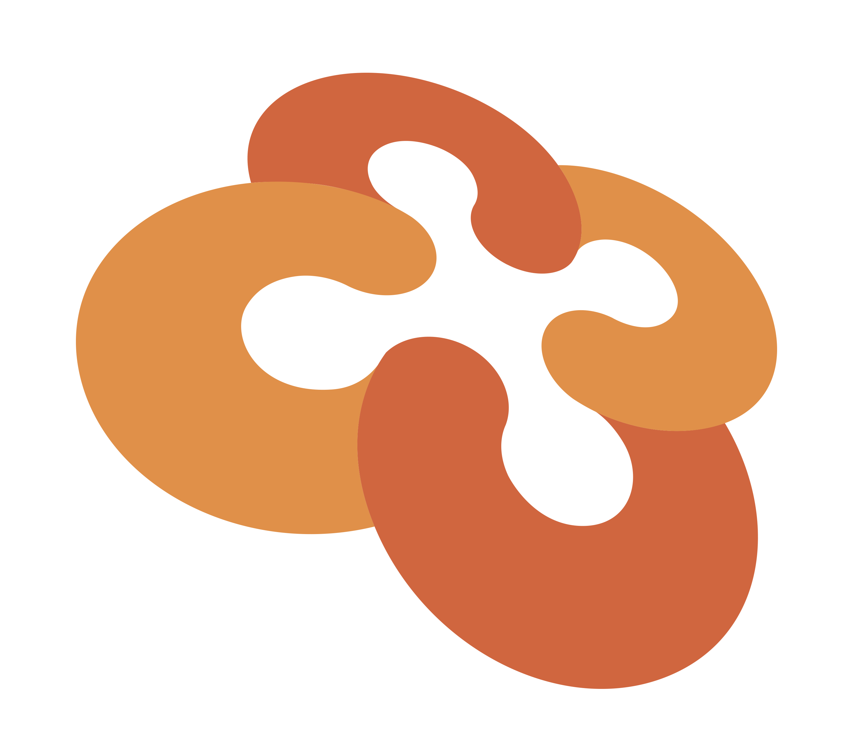
Converge Move
Starter Kit

Slide 2

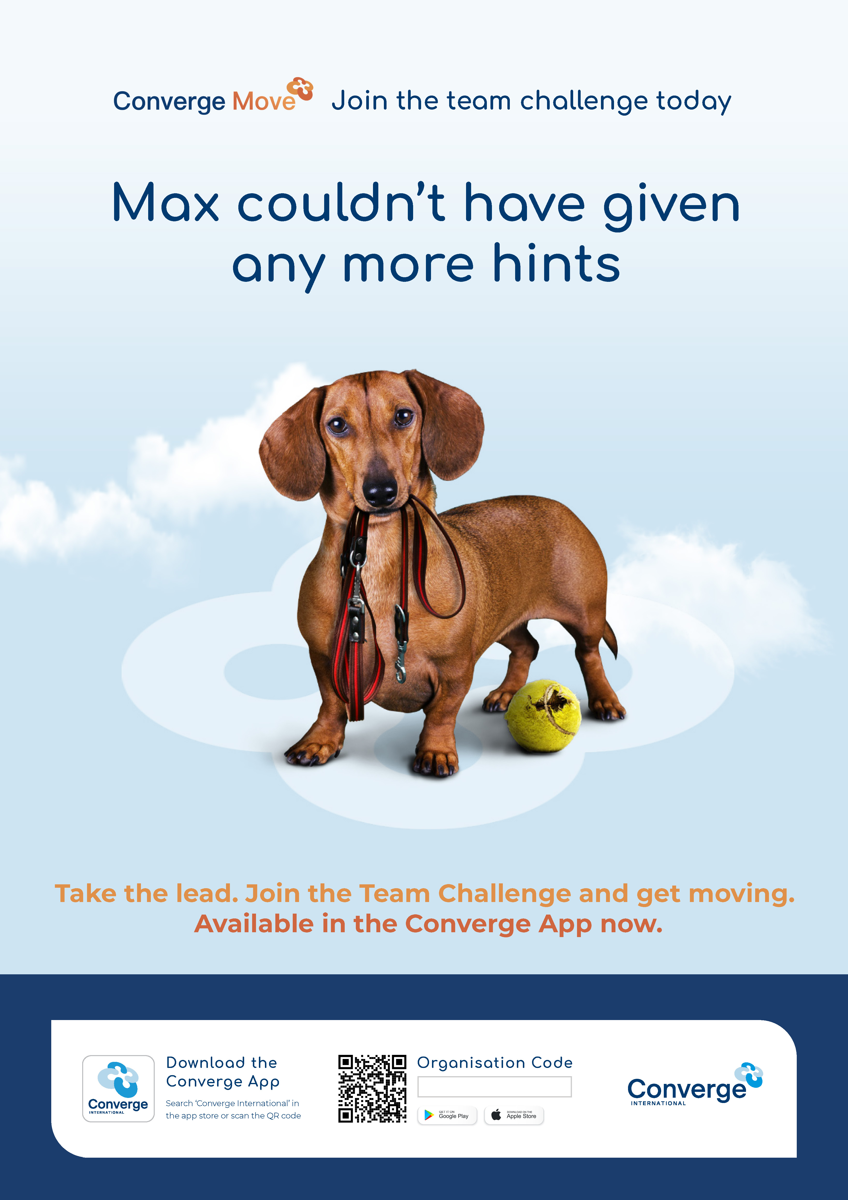
Converge Move: Team Challenge
We know that driving engagement is important, which is why we're offering Converge Move.
Converge Move is a team-based, physical activity challenge that helps to get your people connected and physically moving.
Over the course of six weeks, employees can take on team and individual challenges with a focus on physical activity, good mental wellbeing and social connection.
Converge Move is just one more way to get your employees on the path to health, and it's completely free to use.

Slide 3

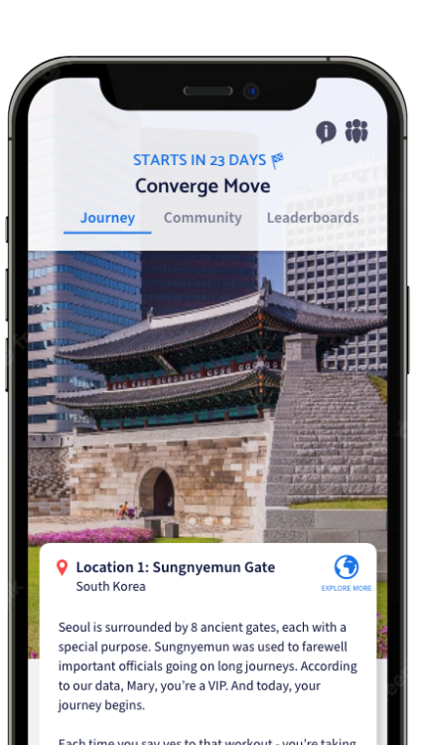
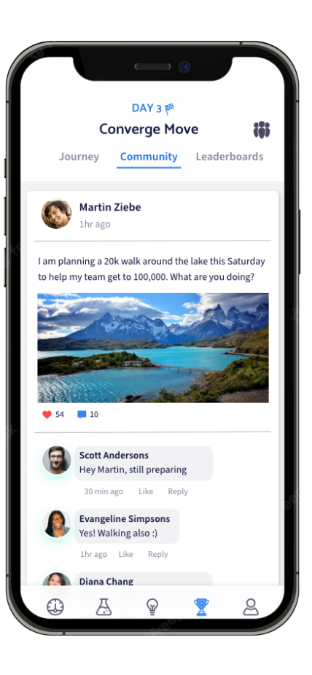
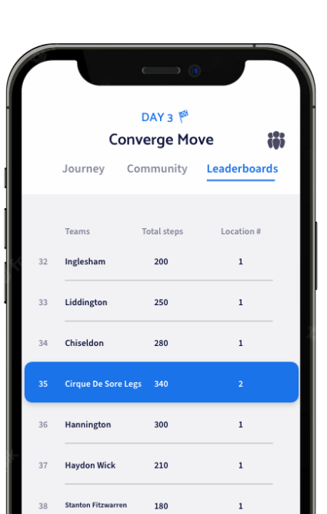
Converge Move: A journey of self-discovery
This is about more than just winning. Converge Move helps employees:
Build healthier habits and improve health and wellbeing
Work together as (virtual) teams
Connect with peers and colleagues
Remain active without expensive programs or training

Slide 4
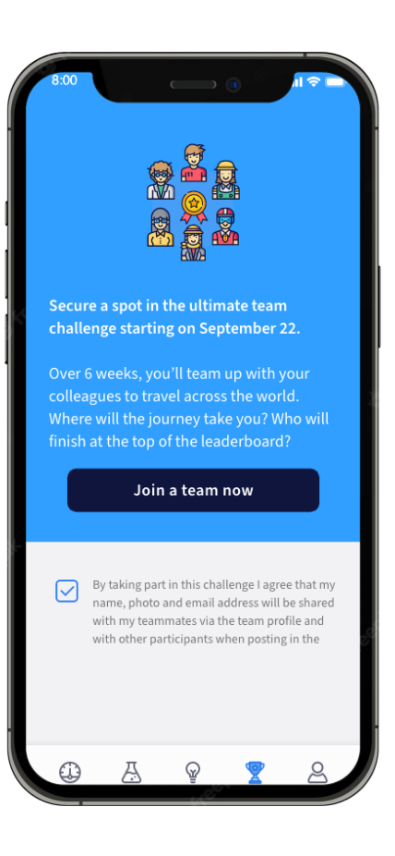
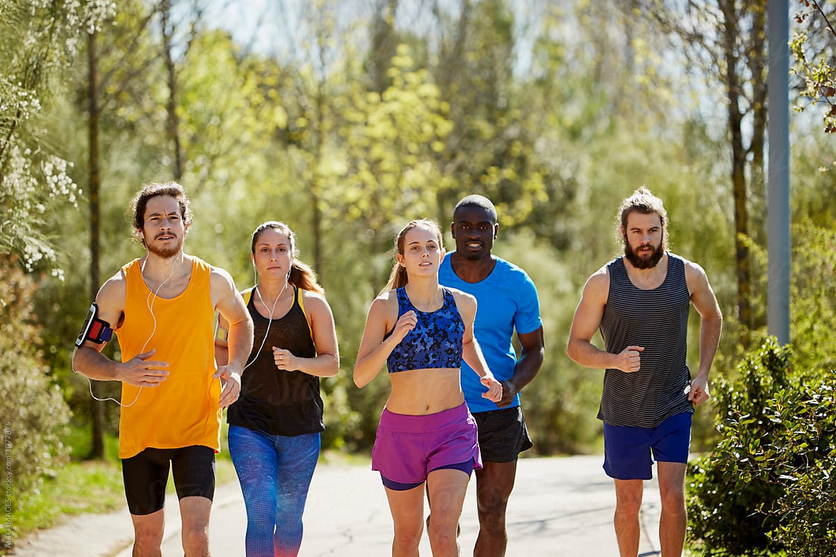
We've made it easy for you
Once your employees have downloaded the app, the setup is easy.
All employees can join the challenge once they've signed up to the app – available for free in the App Store and the Play Store.
Move is accessible to everyone. Your employees can sync with a wide range of devices or enter their workout manually in the app. Every step counts!

Slide 5
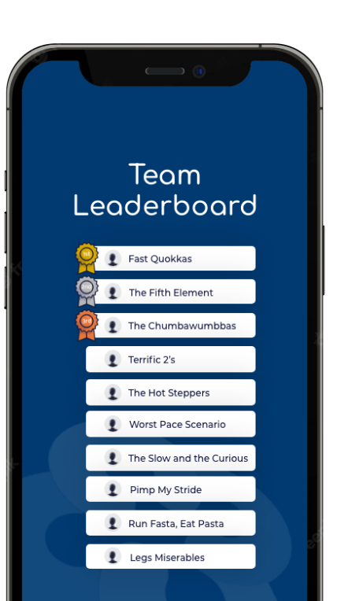
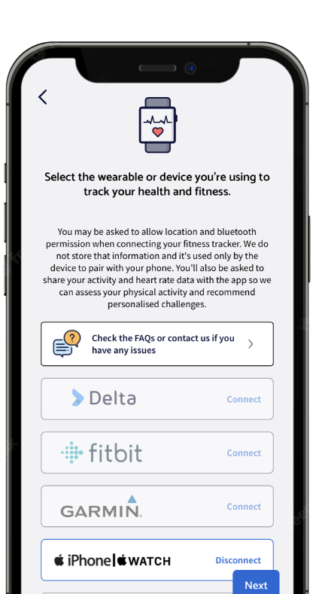
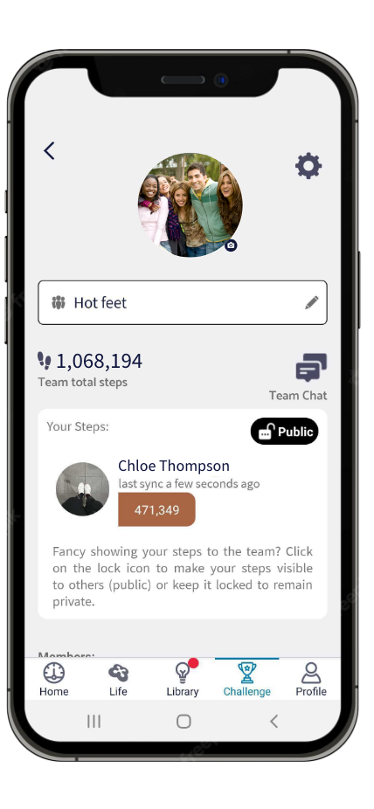
...with many additional features
From Paris to Mt. Fuji, employees can virtually explore the world over 6 weeks
Teams of 6 employees created for you (min 3 in a team)
Company leaderboard
Fully personalised user experience – employees can connect with any wearable device

Slide 6
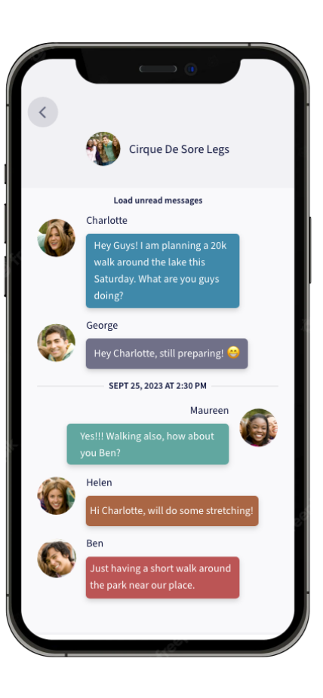
In-app community and team chat to foster connection
Community board for employees to compare journeys and inspire each other
Team chat to exchange tips, celebrate milestones together and cheer each other to stay motivated and healthy together

Slide 7
Converge Move Challenge: Full timeline
Mini-challenge
1: 'Weekend
Warrior'
Mini-challenge 2: 'Mind & Body'
Agree challenge start date with your CRM
Challenge registrations
open in the app for all employees
Challenge’s
end
Challenge’s
report available
Launch day
Challenge setup
Challenge registrations
Challenge in progress
4 weeks
4 weeks
6 weeks
2 weeks
Once you’ve agreed a start date, we take care of the setup for you.
During this time, we recommend that you plan the launch of the challenge with fun activities for your employees! We’ve made lots of suggestions for that and created plenty of material you can use.
Promote the challenge to your employees to build excitement across your workforce and maximise uptake.
Once your employees are signed up, we take care of the comms for you to get them ready and excited. Teams are created randomly by our system.
To keep your employees engaged during the challenge, they’ll receive weekly emails and be invited to take part in 2 mini-challenges.
Celebrate the end of the challenge with your employees by highlighting achievements.

Slide 8
More about mini-challenges
To keep your employees engaged during the challenge, we run 2 mini-challenges.
Mini-challenge #1
In week 2, we kick off with the "Weekend Warrior" challenge to heat up the healthy competition and encourage employees to boost their step count early in their journey.
The employee with the most steps over the course of the weekend wins!
Mini-challenge #2
In week 5, we launch the "Mind and Body" challenge to promote mental wellbeing. Employees are encouraged to check in how they're feeling in the app.
The team with the highest number of Mood Check-in wins!
How do mini-challenge work?
Mini-challenges are promoted via email and push notifications.
All employees are opted in by default.
Winners are announced in the community section of the app.
We provide you with posters to promote the mini-challenges within your organisation.

Slide 9
Step-by-step rollout
Utilise all the comms materials we've created for you: put posters in your offices and use digital assets in your internal channels.
1
Talk to your CRM: agree a launch date for your challenge and schedule your launch webinar
4
Invite your employees to a webinar to launch the challenge. We take care of it for you and will provide video content to get your workforce excited.
2
5
Access your reports for company
health insights.
3
Send a launch email to all your employees with instructions to get started.
6

Slide 10
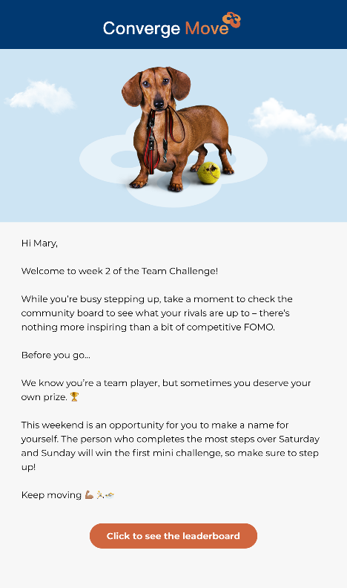
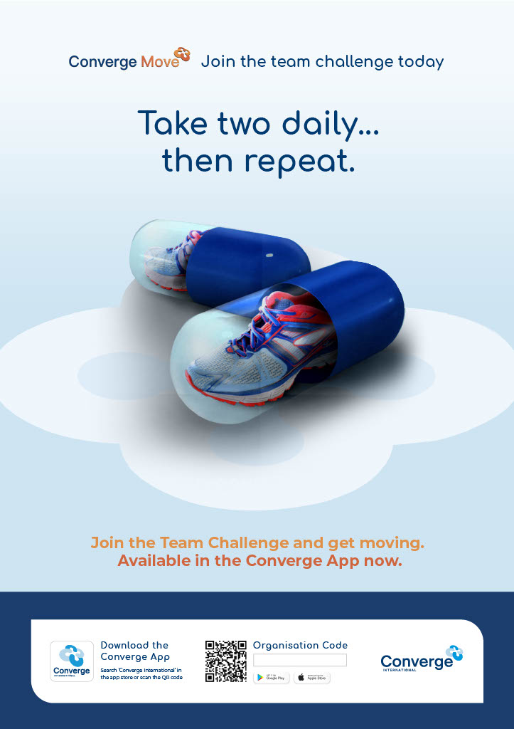
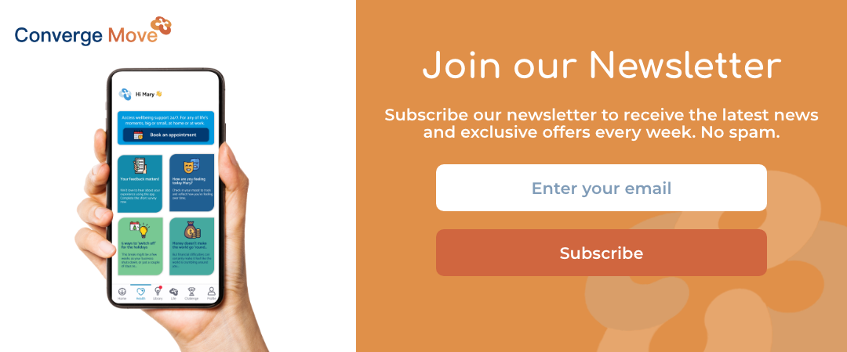

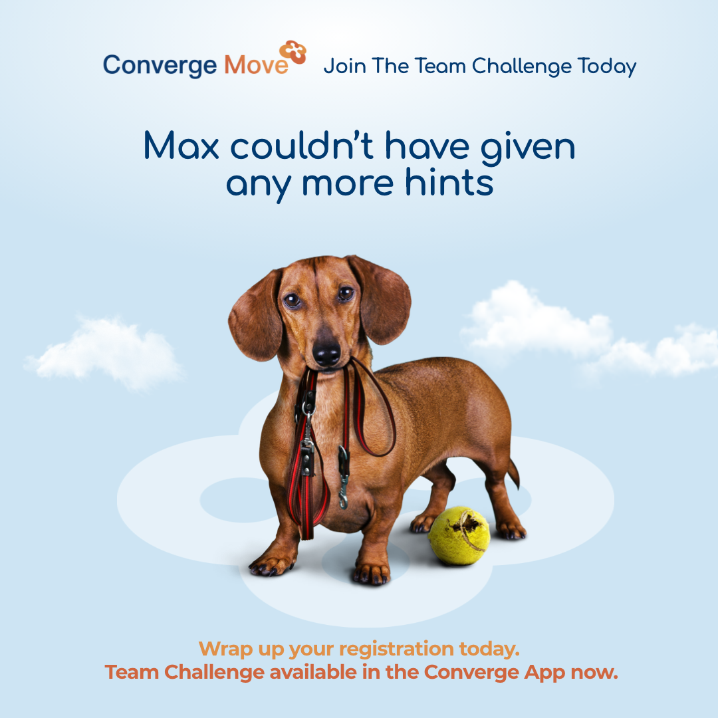
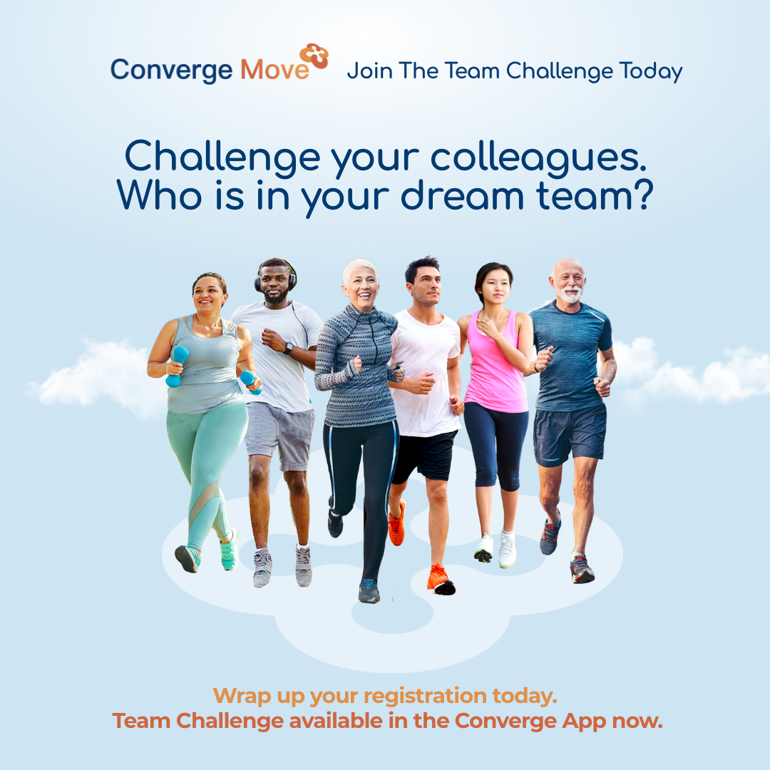
Your unique comms kit
We have developed a series of communication materials for you to launch and promote Converge Move to your employees.
Email Templates
Posters
Digital Assets

Slide 11
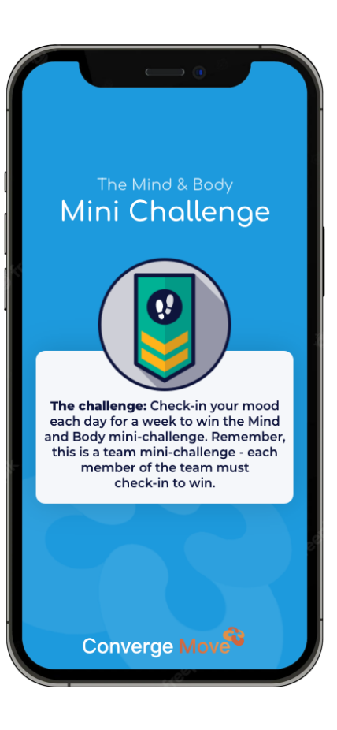
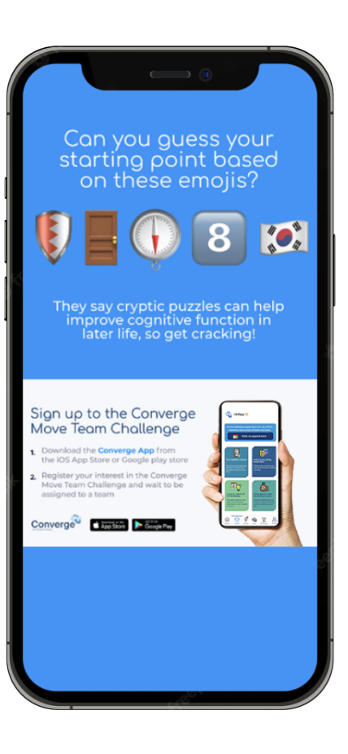
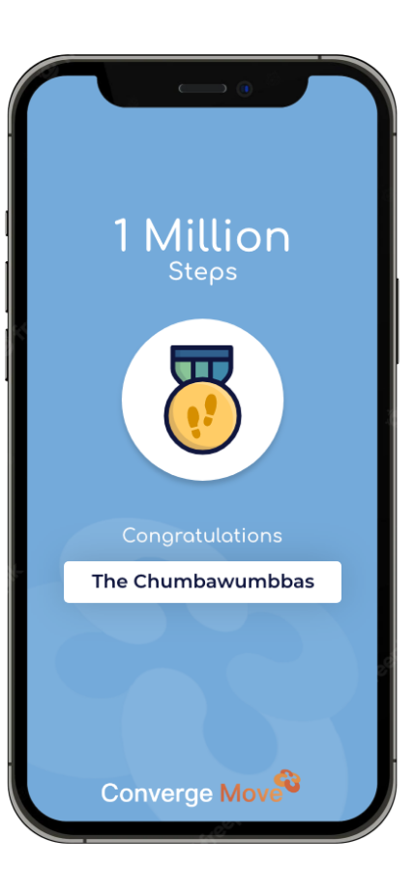
We help you celebrate achievements
We've developed easy-to-use templates for you to reward individuals and teams during the challenge.
Share the updated leaderboard, showcase the mini-challenge winners, celebrate milestones and remind teams about prizes!

Slide 12
Need ideas to promote the challenge?
We've got some tips to help you launch the challenge and keep your employees engaged.
Launch with a bang with a company breakfast or a virtual event to get your people excited.
Get involved in the in-app challenge community: post regular updates and get senior stakeholders involved too.
Share progress with weekly updates on the company team leaderboard.
Reward achievements with individual awards. For example: the employee the most social on the app community, the most creative way to get moving etc.
Run competitions to reward your employees for participating. For example: the best team name, the best team photo etc. Give health promoting rewards like wearable devices to get them motivated.
End of a high with end of challenge celebrations via live company events or virtual end of event party where you can celebrate the winners and share the teams' achievements. Speak to your CRM to access reports on how the challenge is helping them in terms of health gains and risks.

Slide 13
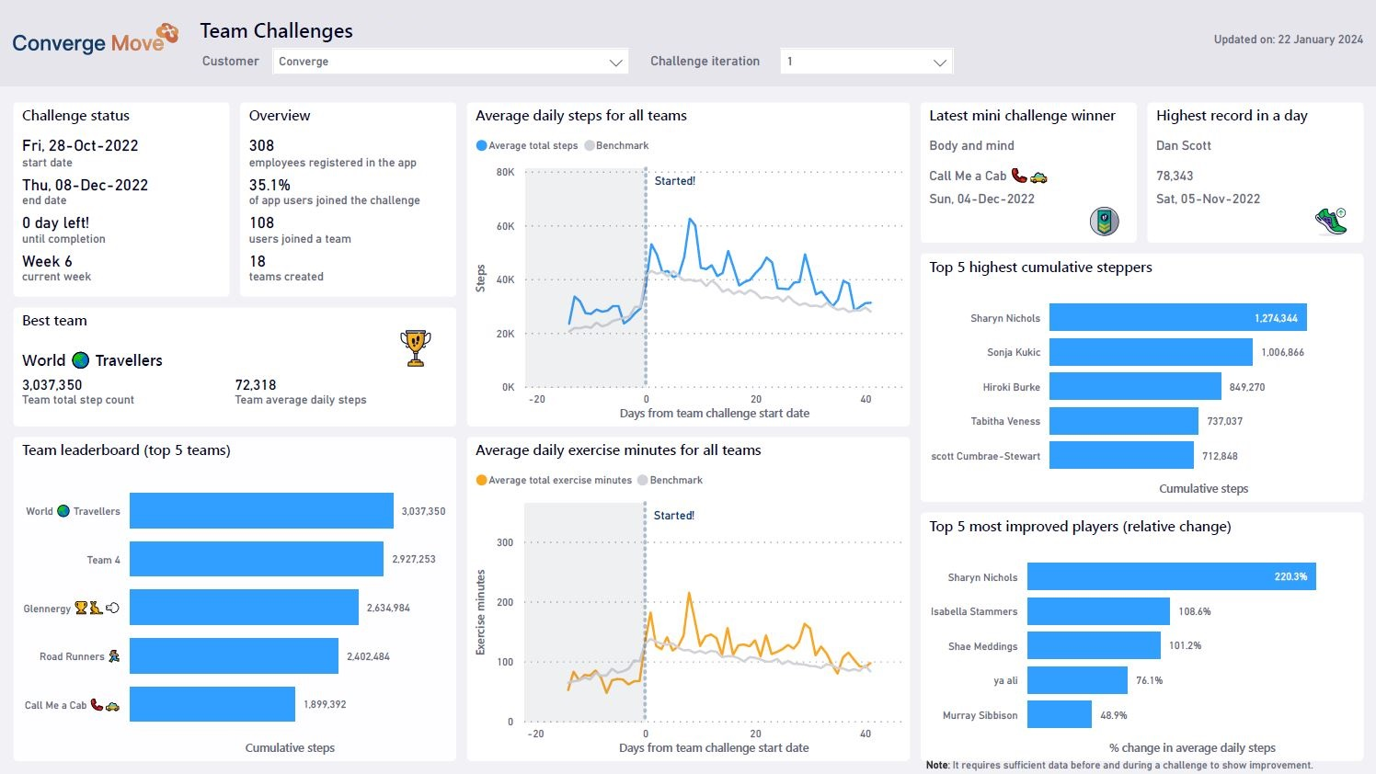
What does it all mean?
Your Move Challenge report will help you keep your workforce engaged by showcasing teams and individual achievements.
​

Slide 14

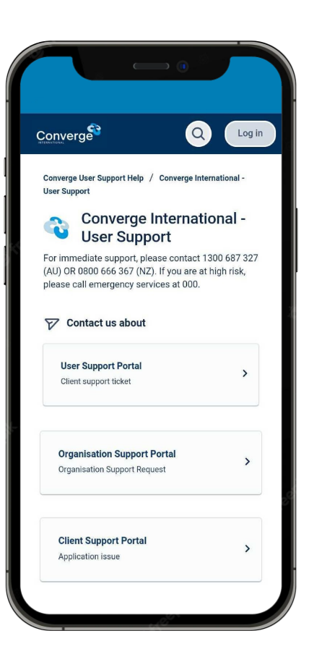
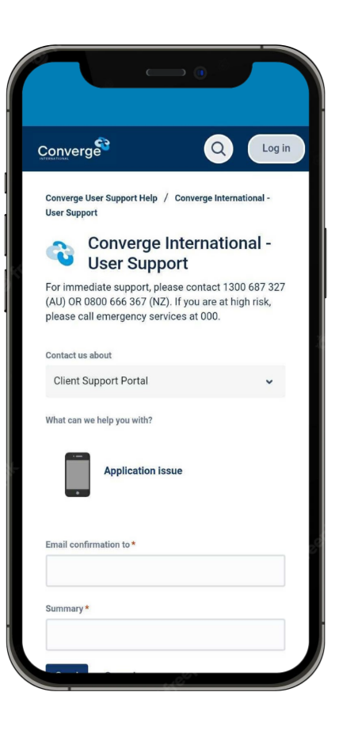
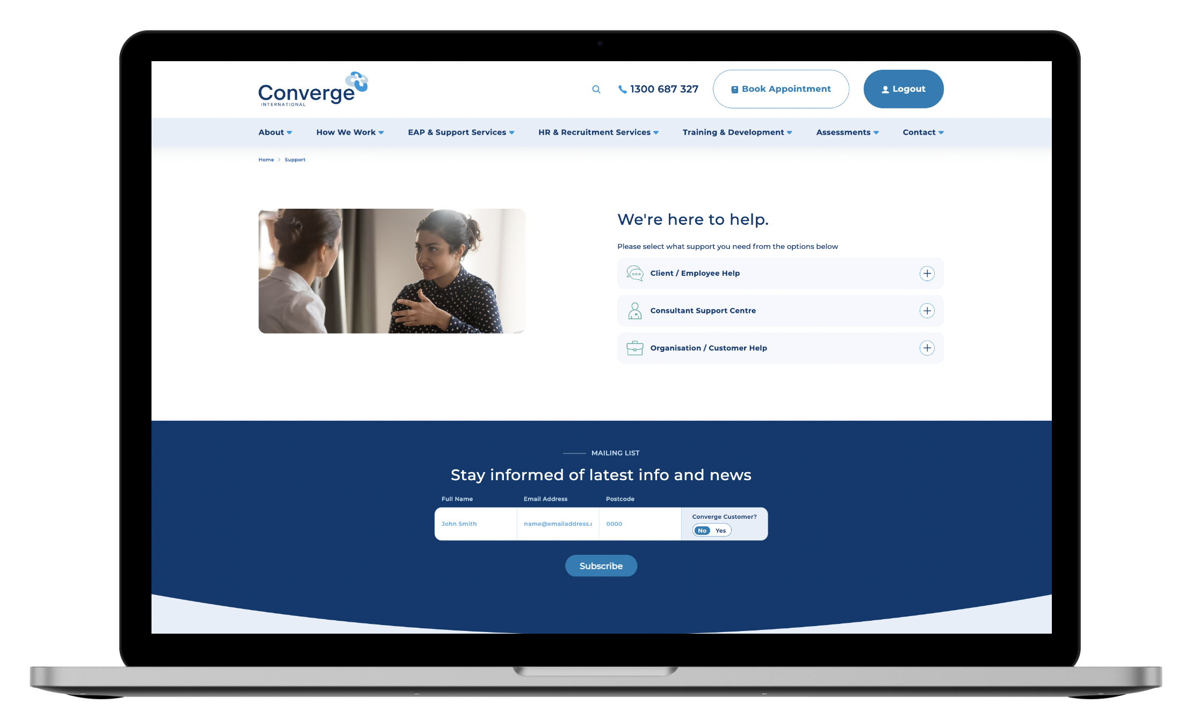
Dedicated customer support
If employees have questions or issues, we're here to help in app or via web.
http://www.convergeinternational.com.au/support

Slide 15
Any questions?
ally@convergeintl.com.au

